Slide 1
UE22CS320A – Project Phase – 2
Capstone Project –Phase 2 –review 2
PROJECT TITLE : AVIOS – Adaptive Vigilant Intelligent Operating System
PROJECT ID : Team 144
PROJECT GUIDE : Prof. Swetha Patil
PROJECT TEAM
Kurumeti Prajval ( PES2UG22CS274 )
Manoj Kumar KS ( PES2UG22CS302 )
Dhanushree K ( PES2UG22CS176 )
Nagaratna ( PES2UG22CS331 )

Slide 2
Expected Deliverables - 1
List of tasks/Modules to be elaborated in discussion with the guide.

Slide 3
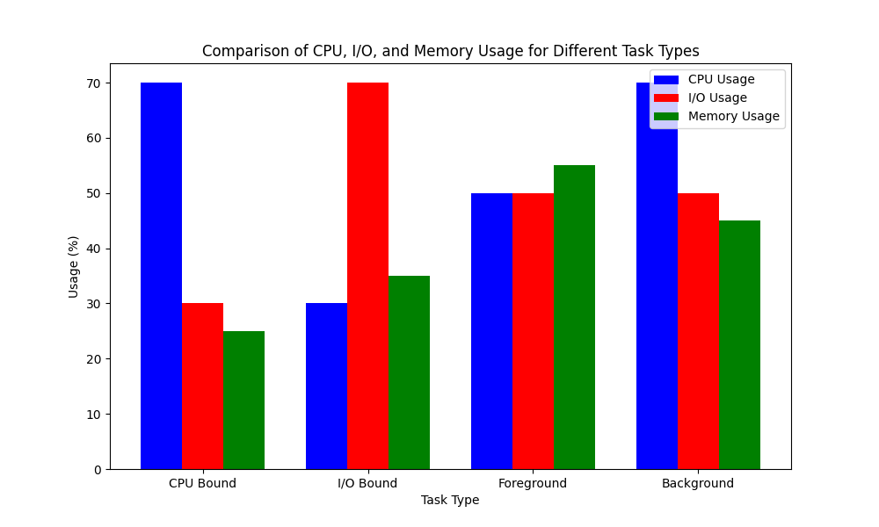
Expected Deliverables - 2
Data Preprocessing: Cleaning and transforming data extracted from Linux distributions. Handling missing values, removing duplicates, normalizing data, and ensuring consistency for accurate analysis.
Data visualization:

Slide 4
Expected Deliverables – 2 (continued…)
Data interpretation:
Storage: Using local storage for quick access and processing, while Google Drive ensures remote access, collaboration, and backup for data security.
Task Type | CPU Usage | I/O Usage | Memory Usage | Other factors
CPU Bound | >= 70% | <=30% | 10% - 40% | Priority, Arrival Time
I/O Bound | <= 30% | >=70% | 20% - 50% | Deadline, Resource Usage
Foreground | >= 50% | >=50% | 40% - 70% | Premptibility, Priority
Background | <= 70% | <=50% | 30% - 60% | Low Priority, Long Execution Time

Slide 5
Expected Deliverables - 3
Name | Task Assigned | Development
Kurumeti Prajval ( PES2UG22CS274 )
Manoj Kumar KS ( PES2UG22CS302)
Dhanushree K ( PES2UG22CS176 )
Nagaratna ( PES2UG22CS331 )

Slide 6
Expected Deliverables
3. Tabulate the individual contribution of the team
members with the following,
Tasks/Modules assigned
Development (no. of lines of code & time spent)
4. List the SDK / API / Model / Jar/ DLL / Tools / Technologies used – Open-Source/ Licensed.
5. 10% implementation of project

Slide 7
Expected Deliverables - 4
Libraries Used
Pandas Library – Data manipulation and analysis.
Numpy Library – Numerical computations and matrix operations.
Sklearn Library – Machine learning toolkit.
SMOTE Library – For treating the data in balance.
Models Used
GAN model – For dataset generation using the existing dataset.
Random forest, SVM and many more models used for predicting the task type

Slide 8
Expected Deliverables - 5
We have started implementing a task classification system using models like Random Forest, SVM, and others. Our focus is on training and evaluating these model’s using metrics like accuracy and precision. We are refining features, tuning hyperparameters, and analyzing misclassifications to improve performance. Through iterative testing, we aim to select the most effective model for accurate and efficient classification. Below are the Accuracy results of models we trained till now:
Random forest: 95.678%
SVM: 86.789%
XgBoost: 92.49%
KNN: 86%
MLP: 91.83%

Slide 9
References
Hongjiu Lu, ELF: From the Programmer’s Perspective, Technical Report, NYNEX Science and Technology, 500 Westchester Avenue, White Plains, NY 10604, USA, May 1995.
Aivazian, Tigran, Linux Kernel 2.4 Internals, The Linux Documentation Project, August 2002.
Maurice Bach, The Design of the Unix Operating System, Pearson Education Asia, pp. 159-170, 2002.
Fredrik Vraalsen, Performance Contracts: Predicting and Monitoring Grid Application Behavior, In Proceedings of the 2nd International Workshop on Grid Computing, November 2001.
Richard Gibbons, A Historical Application Profiler for Use by Parallel Schedulers, Lecture Notes on Computer Science, Volume 1297, pp. 58-75, 1997.
Hyok-Sung Choi and Hee-Chul Yun, Context Switching and IPC Performance Comparison between uClinux and Linux on the ARM9-Based Processor, Linux in Embedded Applications, January 2005. [Online]. .
Warren Smith, Valerie Taylor, and Ian Foster, Predicting Application Run Times Using Historical Information, Job Scheduling Strategies for Parallel Processing, IPPS/SPDP'98 Workshop, March 1998.
Kishore Kumar P. and Atul Negi, Characterizing Process Execution Behaviour Using Machine Learning Techniques, In DpROM Workshop Proceedings, HiPC 2004 International Conference, December 2004.
S.R. Garner, WEKA: The Waikato Environment for Knowledge Analysis, In Proceedings of the New Zealand Computer Science Research Students Conference, pp. 57-64, 1995.
Surkanya Suranauwarat and Hide Taniguchi, The Design, Implementation, and Initial Evaluation of an Advanced Knowledge-Based Process Scheduler, ACM SIGOPS Operating Systems Review, Volume 35, pp. 61-81, October 2001.
Mark A. Hall, Correlation-Based Feature Selection for Machine Learning, Master's Thesis, Department of Computer Science, University of Waikato, pp. 7-9, 12-14, April 1999.
Andrew Marks, A Dynamically Adaptive CPU Scheduler, Master's Thesis, Department of Computer Science, Santa Clara University, pp. 5-9, June 2003.
Robert Love, Linux Kernel Development, 1st ed., Pearson Education, 2004.
Daniel P. Bovet and Marco Cesati, Understanding the Linux Kernel, 2nd ed., O’Reilly & Associates, December 2002.
Tom Mitchell, Machine Learning, 1st ed., McGraw-Hill International Edition, pp. 52-75, 154-183, 230-244, 1997.
O. Duda and P.E. Hart, Pattern Classification, Wiley, New York, 1973.

Slide 10
Thank You

